Slide 1

EE 272 Digital Systems Fall 2019
Instructor: Dr. Aashir Waleed
Lecture 7a – 1
Chapter 6 Registers

Slide 2
Lecture Overview
Lecture 7a – 2
 Parallel Registers – a group of flip-flops in parallel
 Shift registers - a group of flip-flops in series
 Use of registers
 In communication
 In addition
 Reading Assignments:
 Chapter 6 of Textbook

Slide 3

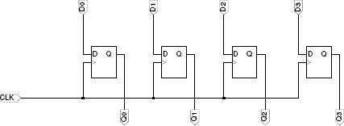
Registers
Lecture 7a – 3
 Registers are groups of flip-flops
 Basic parallel storage register:
 – Store N-bit information
 – Each FF stores one-bit
A 4-bit register:
clk
Parallel Inputs
Register symbol
Parallel Outputs

Slide 4

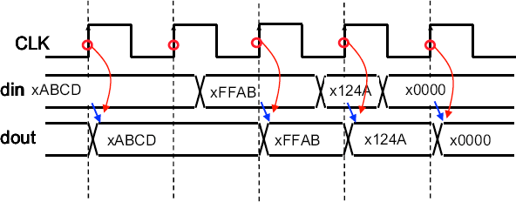
Register – Timing Waveforms
Lecture 7a – 4

Slide 5
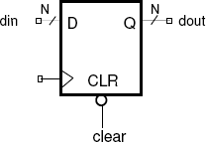
Register with Asynchronous Clear
Lecture 7a – 5
 Registers, just like flip flops, can have additional Clear (reset) and Set (Preset) inputs
 Clear – clear the output to 0
 Set – Set the output to 1
 Could be active low or active high
 Active low – Clear = 0 (set = 0) means clear (set) the output to 0 (1)
 Active high – Clear = 1 (set = 1) means clear (set) the output to 0 (1)
 Asynchronous clear or set – change the output of the register immediately, do not need to wait for the clock edge.

Slide 6
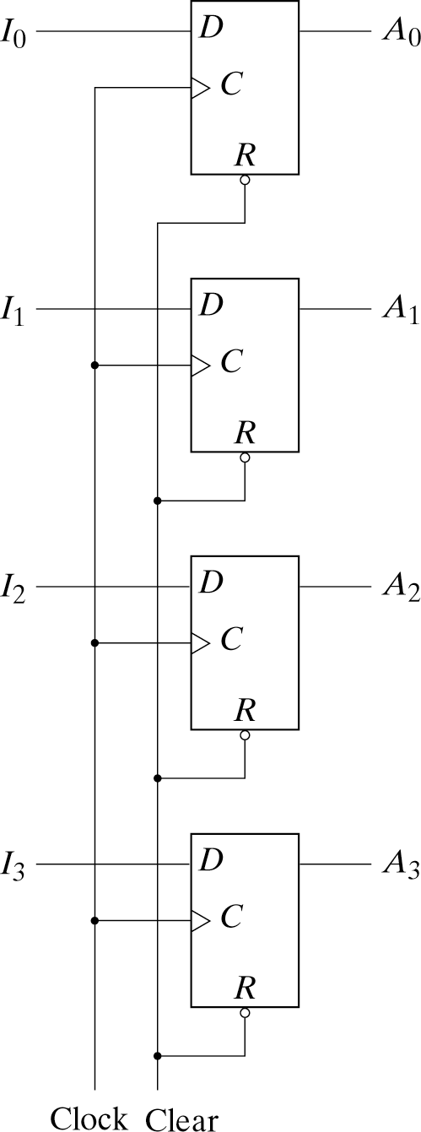
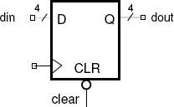
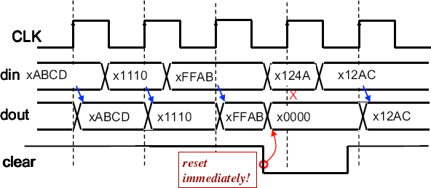
E.g. 4-bit Register with Asynchronous Clear
Lecture 7a – 6
Timing waveform
Implementation using Flip-flops with asynchronous clear

Slide 7
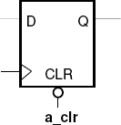

Asynchronous vs. synchronous inputs
Lecture 7a – 7
Asynchronous clear has an immediate effect, do not need to wait for the clock
Synchronous clear changes the output after the next clock edge, basically, the flip flops just load a “ZERO” to the output at the next clock edge
This example show active LOW clear signal. Active HIGH can also be used. How can you do it?

Slide 8

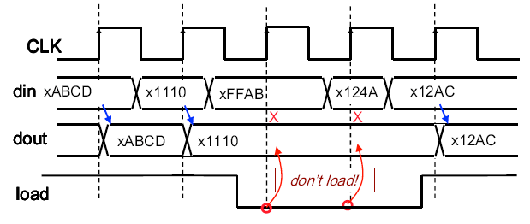
Registers with Parallel Load
Lecture 7a – 8
symbol
 Load (or enable) signal to control whether the data is to be loaded into the register in the next clock edge
 For active HIGH, if load (enable) = 1, the input data will be loaded and stored in the register at the coming clock edge, otherwise no change at the output at the clock edge.
 Load is a synchronous input, i.e. effect at the output only happen at the next clock edge.
Timing waveform

Slide 9
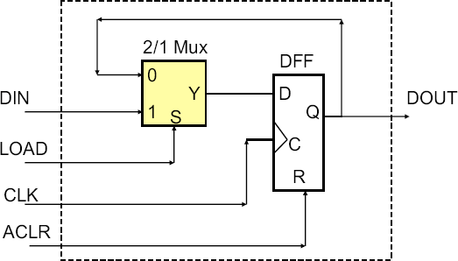
Implementation of 1-bit “Register with Load” using D-Flip Flop and Mux
Note that DFF simply loads old value when LOAD = 0.
DFF is loaded every clock cycle.

Slide 10
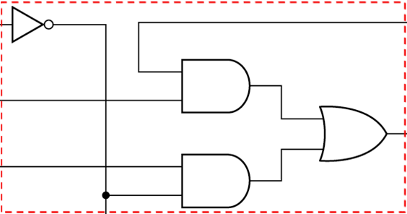
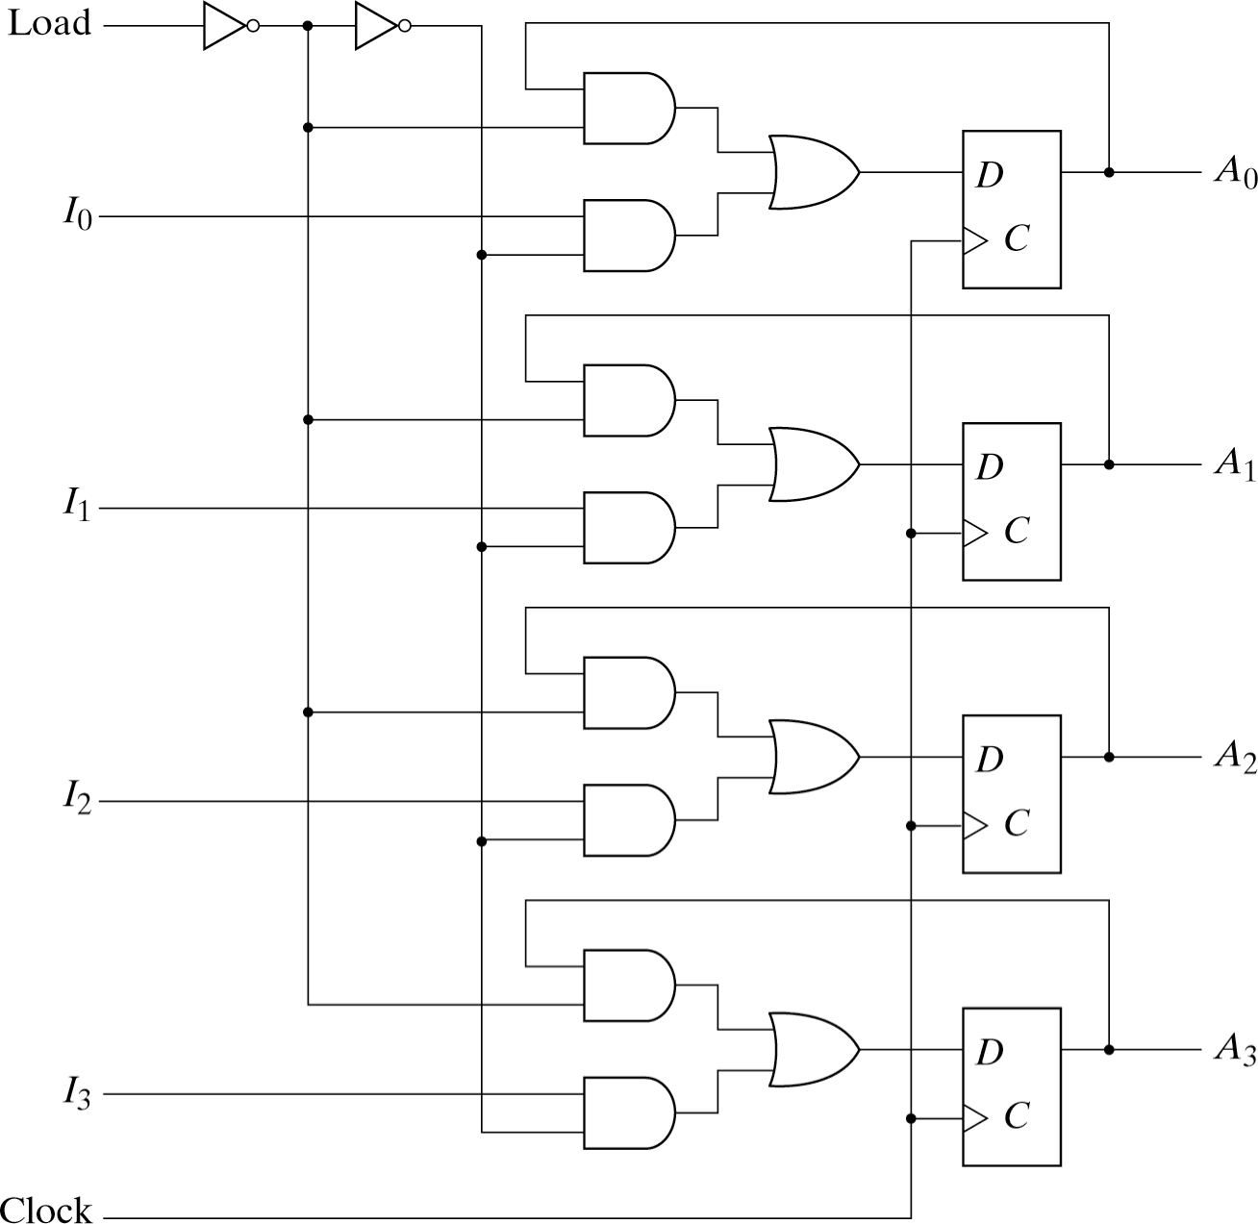
4-bit register with Load (Enable)
Lecture 7a – 10

Slide 11
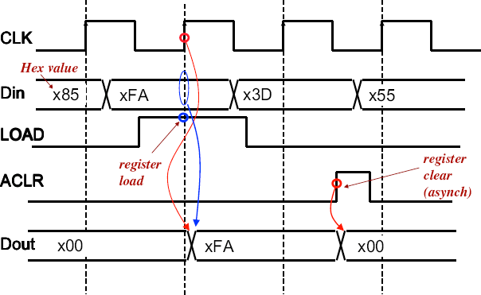
Timing Waveform of a 8-bit register with load and asynchronous clear

Slide 12
Shift register
Lecture 7a – 12
Cascading of flip-flops in series to form a shift register
– New value to first stage while the second stage obtains current value of the first stage
» Shift function (in-series arrangement)
» Storage function (by flip-flop)
IN _{D Q} Q0 _{D Q} Q1
Q’
Q’
CLK
100
IN Q0 Q1 CLK

Slide 13
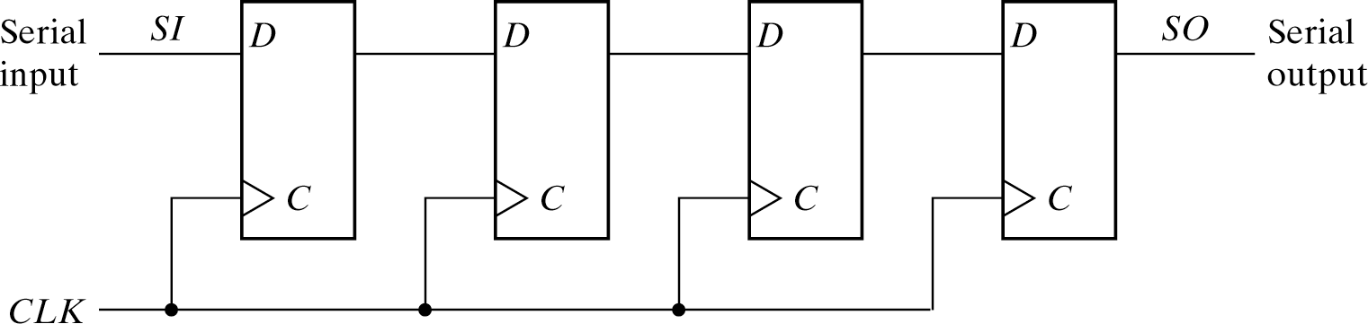



4-bit Shift Register
Lecture 7a – 13
Q₁ 1 | Q 2 0 | Q ₃ 0 | Q₄ 0
0 | 1 | 0 | 0
0 | 0 | 1 | 0
0 | 0 | 0 | 1
Shift
Shift Shift

Slide 14
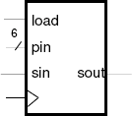
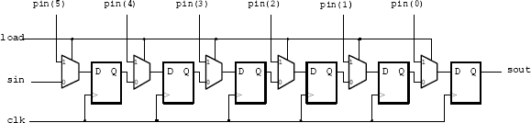

Parallel Input Serial Output (PISO) shift register
 Specifications:, e.g.
 – 6 bits
 – Rising edge triggered
 – Loaded (synchronously) when load = ‘1’
 – Data shifted-out LSB first

Slide 15
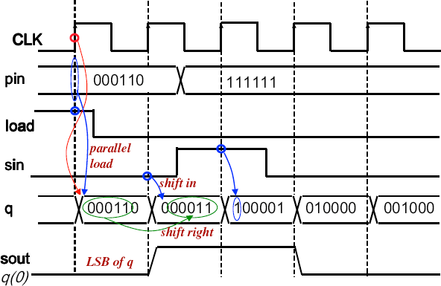
Shift Register Timing Waveforms
Lecture 7a – 15

Slide 16
Universal Shift Register
Lecture 7a – 16
Combinate combinational and sequential circuits for more functions
Support shift in both direction
Support both shifts and parallel-load capabilities

Slide 17
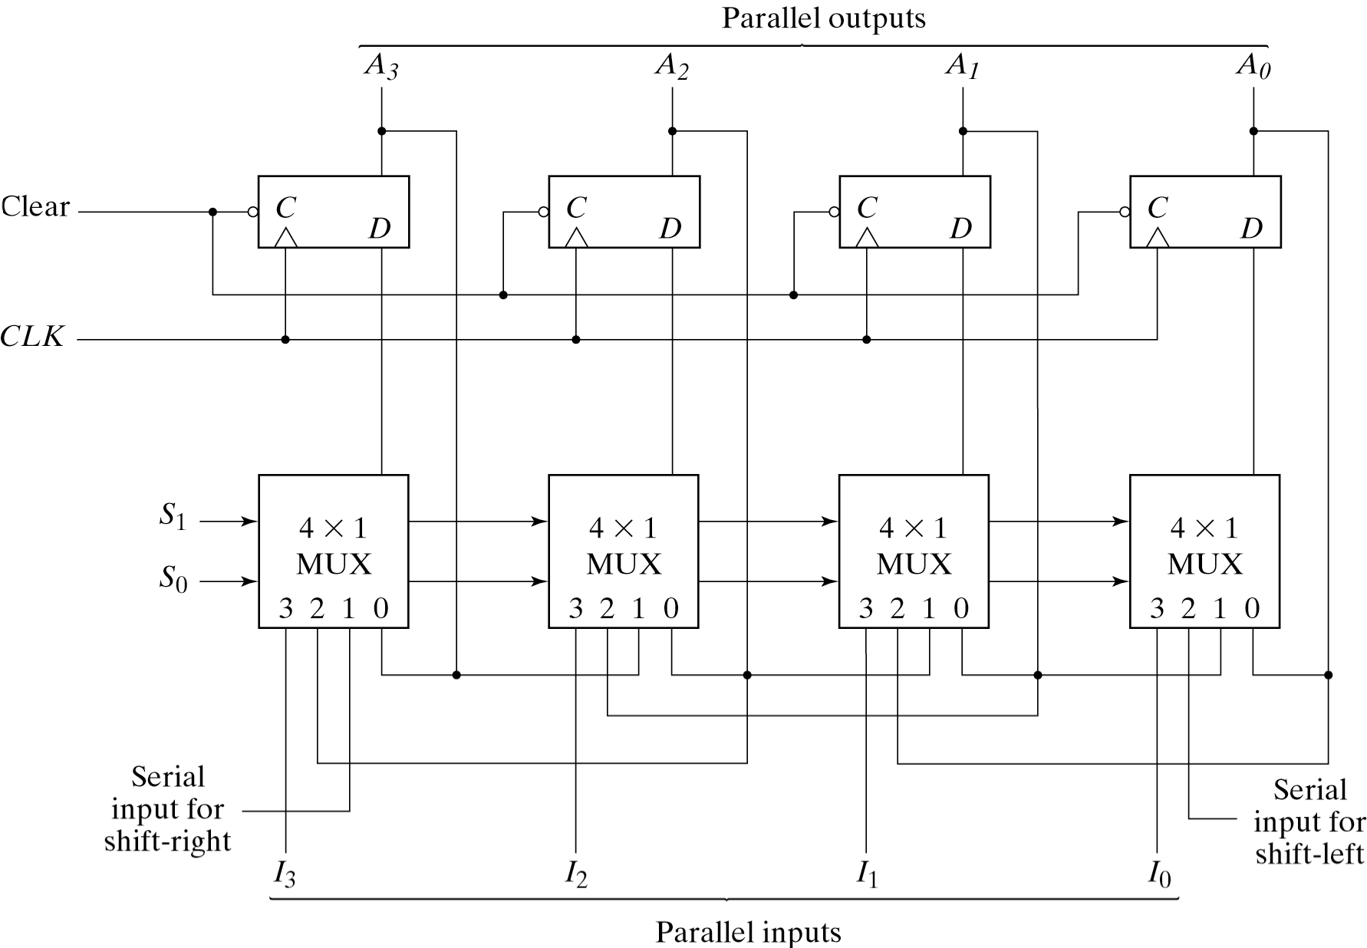
Universal Shift Register (Cont’d)
Lecture 7a – 17
S₁ S₀
0 0 → Keep Data
1 → Shift Right
0 → Shift Left
1 1 → Parallel Load

Slide 18
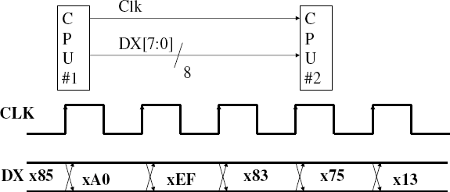
Application example–data transfer
Lecture 7a – 19
 Parallel data transfer
 Multiple number of bits are transferred from one place to another (e.g. from one processor to the other processor)
 Use parallel registers in the source and destination
 Requires a lot of lines between the sources and destination, that may be expensive especially if the distance is long and the speed of transfer is high

Slide 19
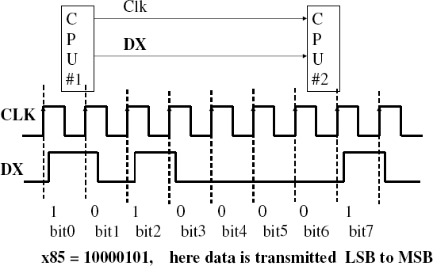
Lecture 7a – 20
Application example–serial data transfer
 To reduce the number of parallel wires, we can transfer data in serial fashion, i.e. one bit at a time.

